Slide 1
Keyword Auctions
INFO 4220 – Networks II: Market Design
Based on Haeringer Ch. 5

Slide 2

This was the first banner ad in the internet
  Published in October 27, 1994 when Wired magazine (then named hotwired.com) went online
Everyone at the time was trying to monetize online publishing
How things evolved is really interesting (and a long story). Let’s just say that it resulted in:
  Online tracking
  Obtrusive advertising to get your attention
  And a multi-billion industry
And now it all runs on auctions, millions of them a day

Slide 3
Two Main Innovations of Online Advertising
John Wanamaker (1838-1922):
“Half the money I spend on advertising is wasted;
the trouble is I don't know which half”
Online advertising promises to fix this problem:
  Money that is wasted by showing ads to people not interested in your product: Use tracking to target
  Money that is wasted by ads that are not noticed: Only pay when users engage (Pay-per-click)
Moreover, they can take it one step further:
  Advertisers can track people online and learn what they like
  And then show them ads of things they will like (retargeting)

Slide 4
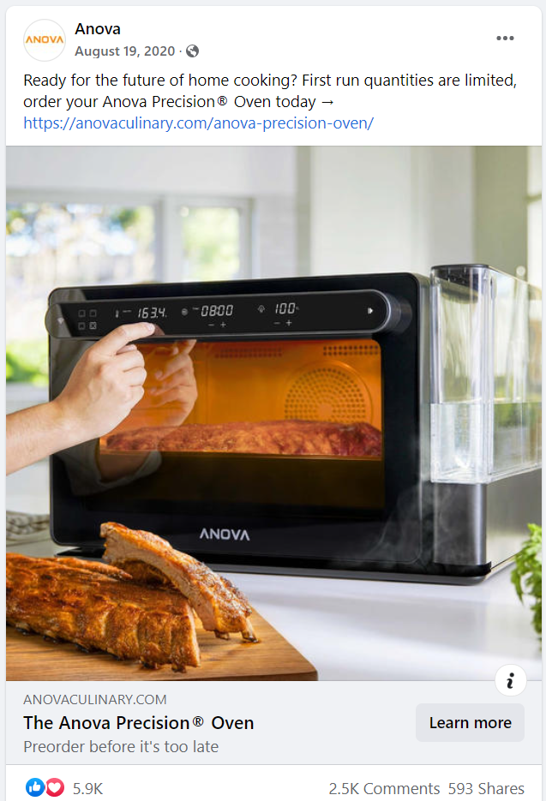

Slide 5
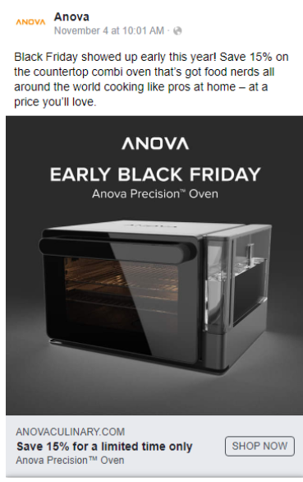

Slide 6
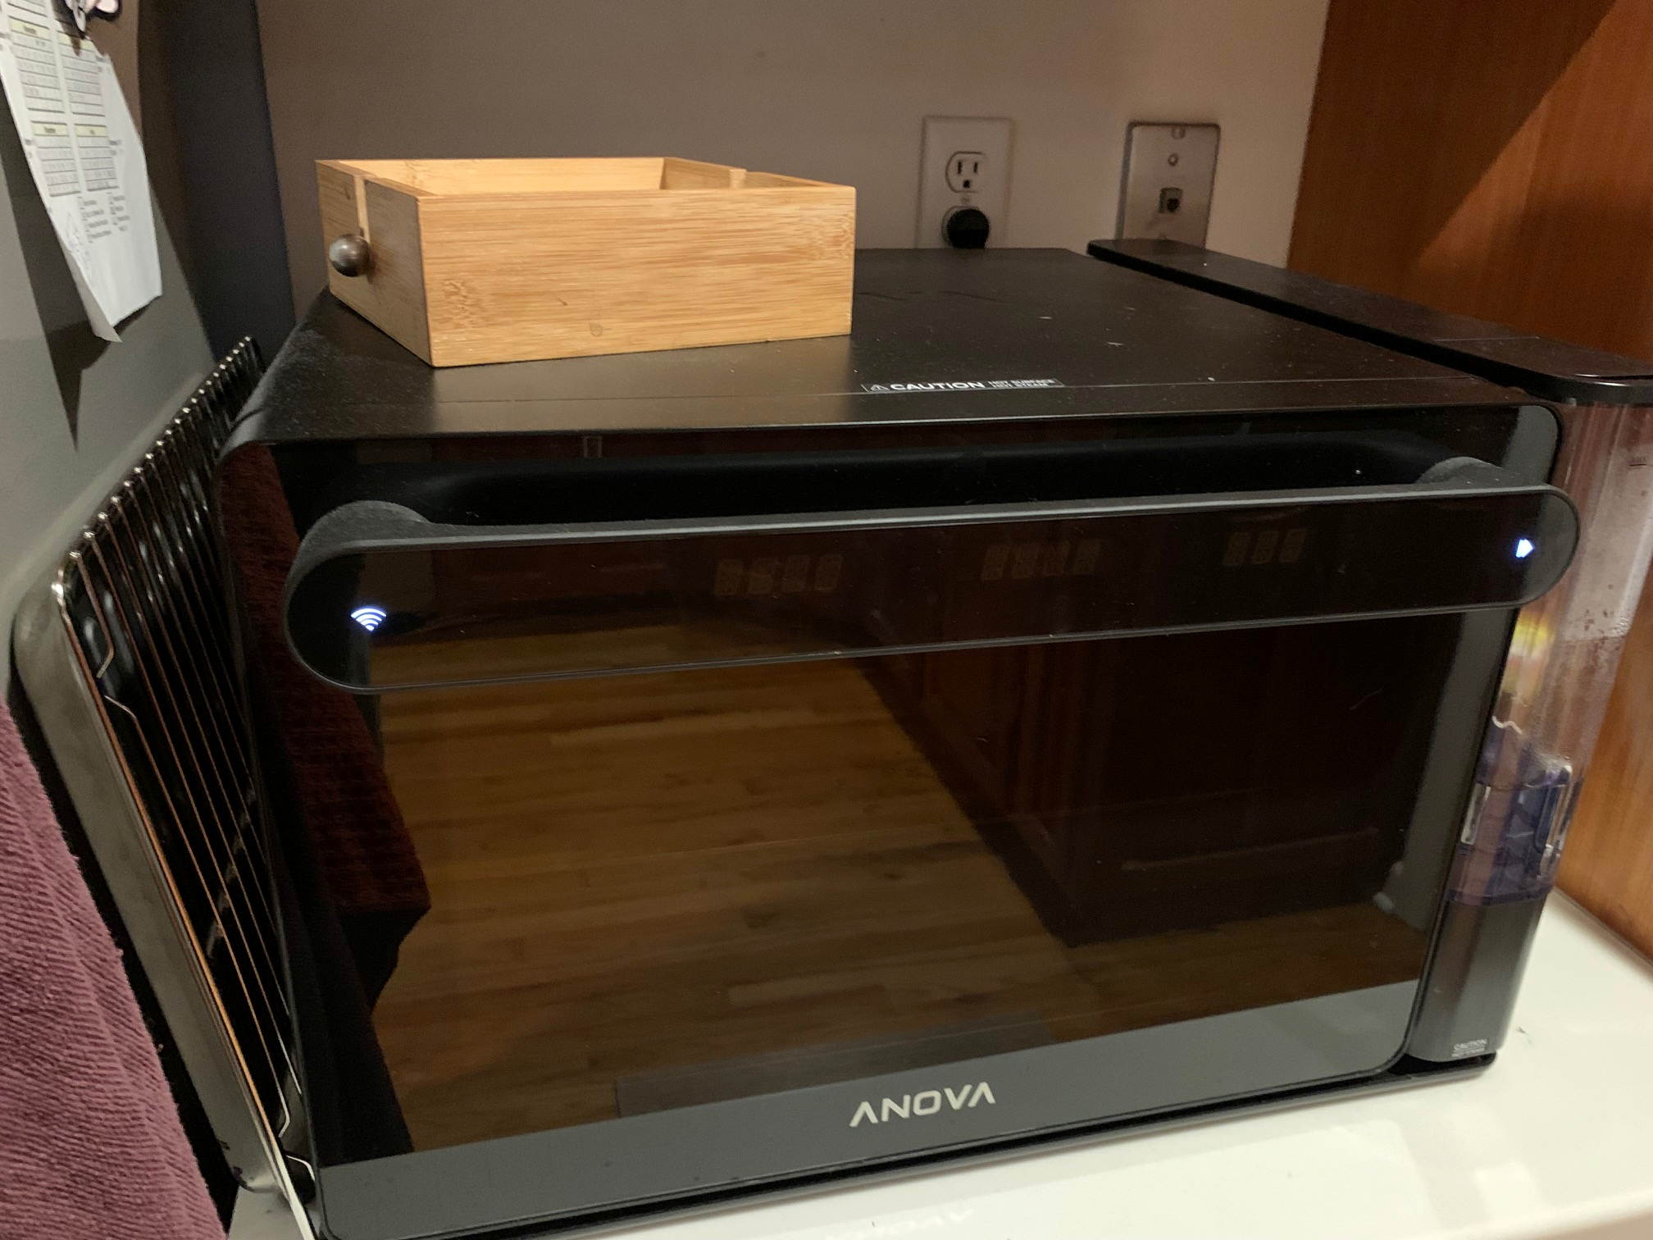

Slide 7
Types of Online Ads

Slide 8
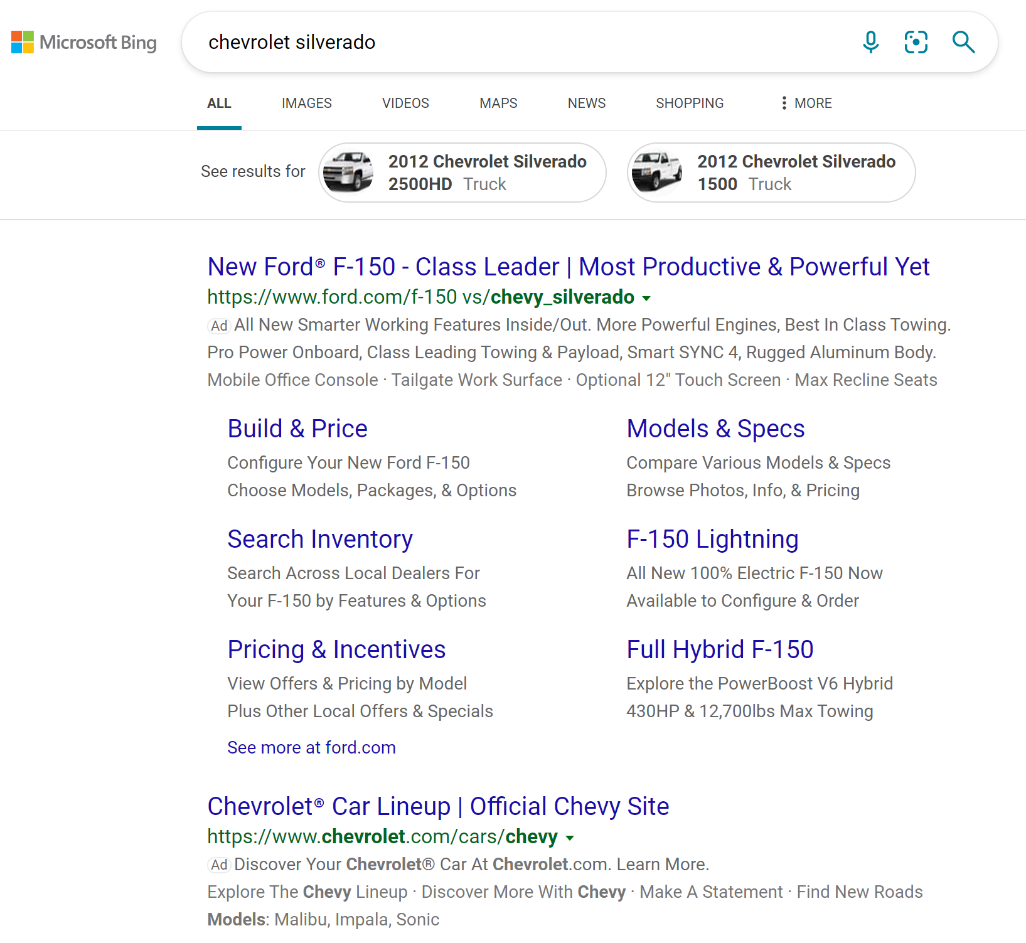
Keyword/Search Advertising

Slide 9
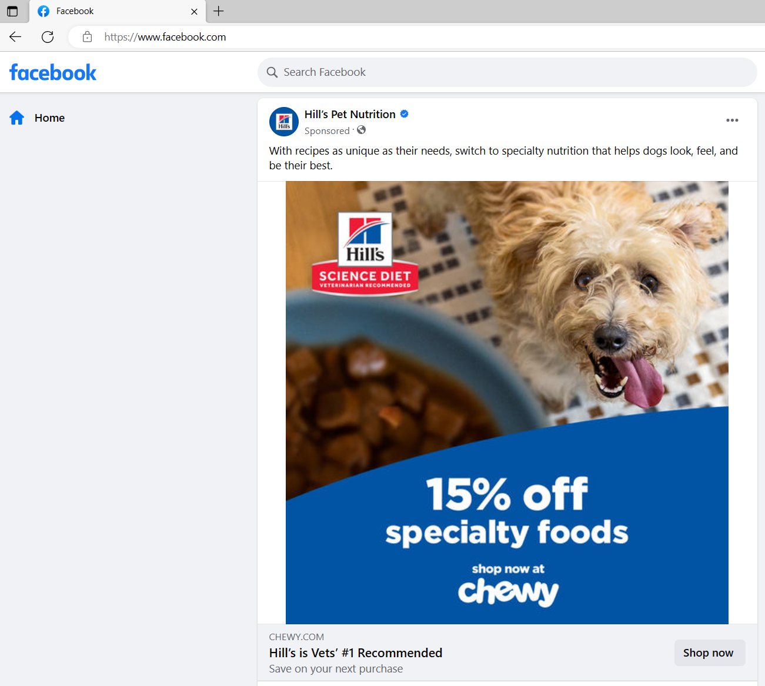
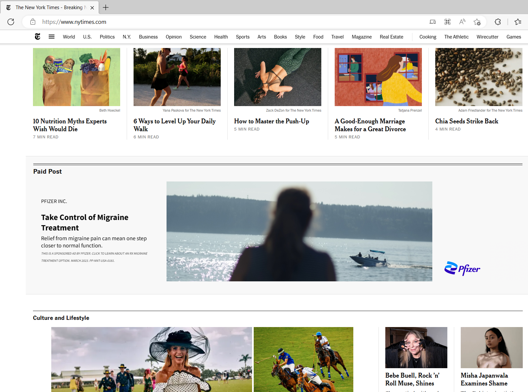
Display Advertising

Slide 10
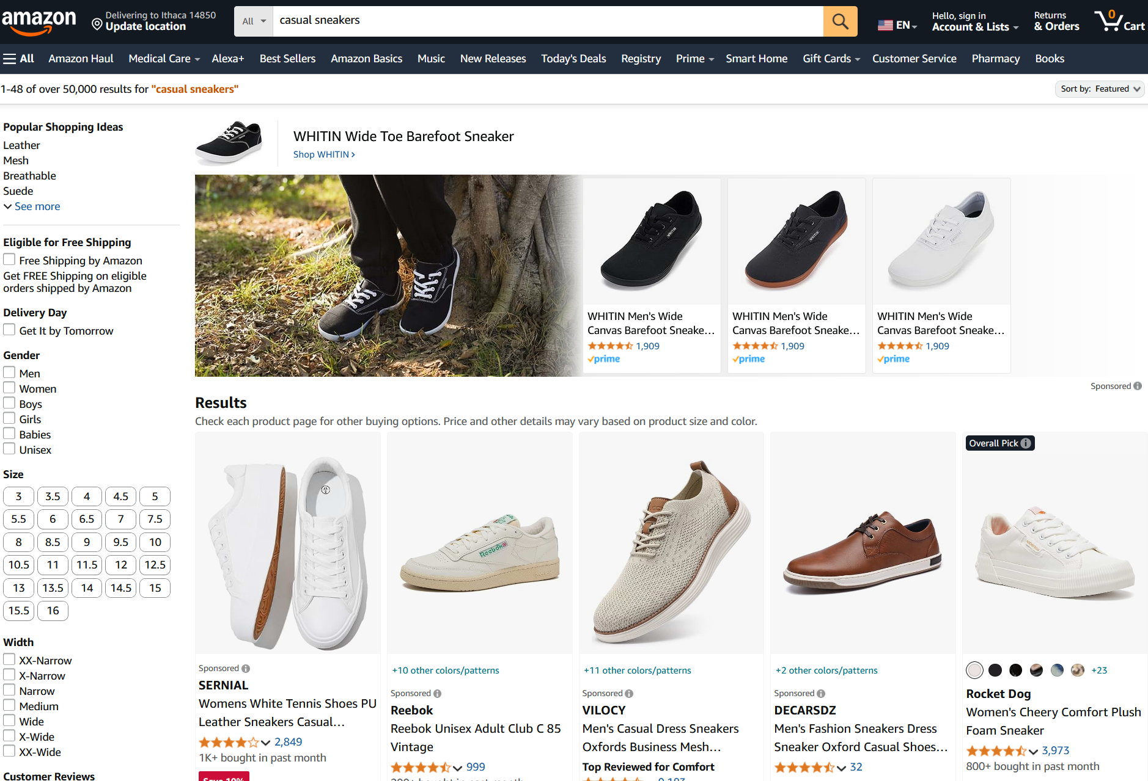
Sponsored Product

Slide 11
Keyword Advertising
Most profitable source of advertising:
  Search engine knows well what you are looking for
You enter a search “query”
Get results:
  First: Sponsored links (ads)
  Second: Most relevant links (organic results)
When users click on sponsored link:
  Sent to advertiser’s page
  Advertiser pays the search engine for sending the user
Position of the sponsored link matters. Higher displayed positions are clicked more frequently

Slide 12
How Big is This?
Google valued > US$1.8 trillion
  They don’t publish the figures, but analysts often say they make about 76% of their revenues from online ads
  Google pays Apple $20 billion per year to be the default search engine in iOS devices
Prices per click vary a lot, from a few cents to hundreds of dollars.
  Price determined by profitability of transaction, and probability of converting a click on a sale
Keyword | Cost per Click
Insurance | $54
Loans | $45
Mortgage | $45
Attorney | $45
Credit | $35

Slide 13
Origins
First service to use auctions for displayed online ads using Pay-per-click (CPC) was GoTo in 1997*
  It worked fast, in real time (bidders could adjust their bid at any moment)
  Popular: Yahoo!, MSN used it
  But, fast changing bids made the system unstable
They used a first-price auction:
  Bidders ranked according to their bid
  Each bidder pays its bid (1st price auction)
*Renamed Overture in 2001, bought by Yahoo! In 2003

Slide 14
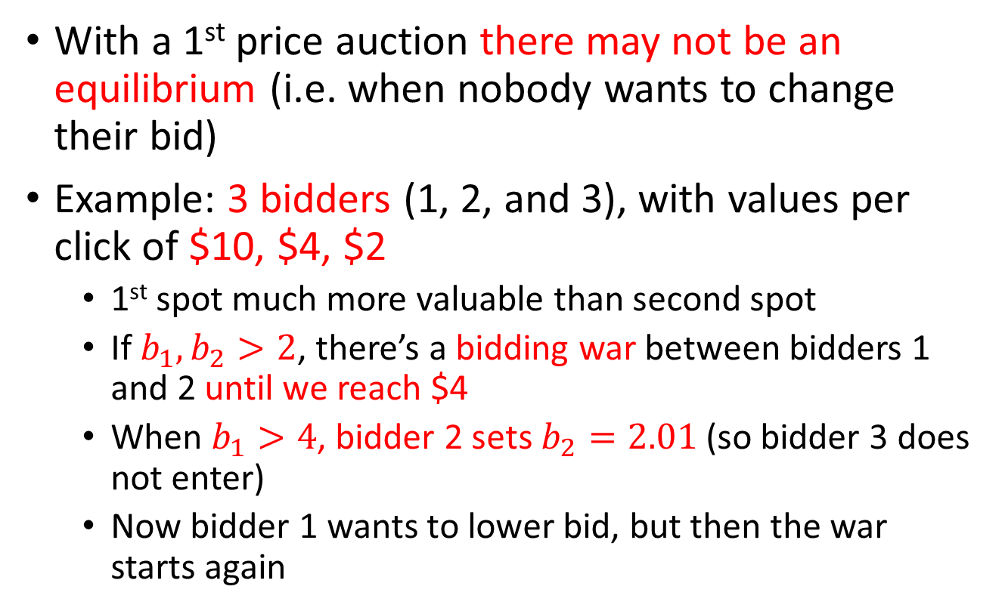
Issues with GoTo’s auction
With a 1st price auction there may not be an equilibrium (i.e. when nobody wants to change their bid)
Example: 3 bidders (1, 2, and 3), with values per click of $10, $4, $2
  1st spot much more valuable than second spot
  If $b_{1},b_{2}>2$, there’s a bidding war between bidders 1 and 2 until we reach $4
  When $b_{1}>4$, bidder 2 sets $b_{2}=2.01$ (so bidder 3 does not enter)
  Now bidder 1 wants to lower bid, but then the war starts again

Slide 15
Issues with GoTo’s auction
If bidder 1 uses a (fast) robot to bid, while bidders 2 and 3 are (slow) humans. Let’s assume:
  Bidder 2 checks bids every 2 hours and increases its bid by 0.5 until getting the first spot, unless the price is over 4, in which case it bids 2.01 to get the second spot
  Bidder 1 has a bot that checks bids every 1 minute and increases its bid in 0.01 increments until getting the first spot

Slide 16
Issues with GoTo’s auction
At time 0 bidder 2 is bidding 2.01, bidder’s one robot bids 2.02
2 hours later, bidder 2 realizes they are not longer winning, increases bid to 2.51 and wins
1 minute later, bidder 1’s robot bids 2.52 and recovers the first spot
2 hours later, bidder 2 realizes they are no longer winning, increases bid to 3.01
1 minute later, bidder 1’s robot bids 3.02 and recovers the first spot ….
Eventually bidder 2 would need to bid >4, thus they reduce bid to 2.01 and settle for second spot. One minute later, bidder 1’s robot realizes and lowers bid to 2.02

Slide 17
Issues with GoTo’s auction
What is going to happen:
  Bids stay slightly above $2 for long periods of time
  Seller’s revenue (i.e. search engine’s revenue) are low (even though sellers’ 1 and 2 valuations are much higher than $2)
Experience is very frustrating for bidder 2 that always gets outbid

Slide 18
Bidders are bidding for multiple objects
Users’ click rate depends on the rank of the ad in the page:
  Each position can be interpreted as a different items
  Search engines should run multiple items auctions: Multiple items are being sold at the same time
Bidders only submit a single bid:
  A higher position is always better: Bidders have the same preferences over appearing first
  The value per-click does not depend on the position: The probability of conversion does not depend on it
  This does not mean the probability of conversion is the same across advertisers

Slide 19
Generalized Second Price Auction
Each advertiser places a bid
Bids are ranked:
  Highest bidder is shown first
  2nd highest bidder is shown second
  3rd highest bidder is shown third …
  Last bidder is not shown
The k-th bidder pays the bid (if the user clicks) of the (k+1)-th bidder
There is always at least 1 more bidder than the number of links awarded

Slide 20
Payoff flows
Click-through-rate: Probability of ads being clicked
Advertisers (bidders) need to think in terms of expectation of users consuming the good
  Or in other terms of flows of payoffs
Easier to think in terms of click frequency:
  How many click the ad gets per unit of time

Slide 21
Example
An advertiser values a click in $4
If ad is placed first (A), it gets 200 clicks/hour
  And the cost per click is $3
If the ad is placed second (B), it gets 40 clicks/hour
  And the cost per click is $1
Which of these positions is better?
  Net payoff per click better for position B:
  (A) $4 - $3 < (B) $4 - $1
  Net payoff per hour better for position A:
  (A) 200 * ($4 - $3) > (B) 50 * ($4 - $1)

Slide 22
Quality Score
In 2005 Google modified the rules of the GSP auction
Google gets paid only when people click on the Ad
  And ad-frequency depends on the advertiser
  If advertiser doesn’t get clicks, Google doesn’t make any money
  Google needs a way to give priority to advertiser A
Revenue w/ Adv. A |  | Revenue w/ Adv. B
$1 / click |  | $50 / click
Gets 1000 clicks/hour | > | Gets 10 clicks/hour
= $1000 / hour |  | = $500 / hour

Slide 23
Quality Score
For each advertiser Google determines a quality score that depends on:
  CTR
  Ad relevance
  User experience
  Other things Google won’t say
Example: Do a search for “car deals”
 | User Is
 | Age 24-30 | Age 35-45
Compact Car | High Score | Low Score
Minivan | Low Score | High Score
Hearing Aids | Very Low Score | Very Low Score

Slide 24
Pricing With Quality Score
Bids are adjusted by the quality score
For each bidder
  Final Score = Bid * Quality Score
Advertisers ranked according to the final score
Charge the k-th advertiser the lowest price per click p such that:
  p * quality score > final score of (k+1)-th bidder

Slide 25
Example: Finding Prices in GSP
Bidder | A | B | C
Bids | $6 | $4 | $2
Quality Score | 2 | 4 | 1
How do we determine the winners and the price they have to pay?

Slide 26
Example: Finding Prices in GSP
Bidder | A | B | C
Bids | $6 | $4 | $2
Quality Score | 2 | 4 | 1
Final Score | 12 | 16 | 2
Ranking | 2nd | 1st | 3rd
Price per click | $1.01 | $3.01 | $0
B needs a score higher than 12 to win against A
  If she bids $3.01, her final score is 12.04
  So the price for B is $3.01 per click
A needs a score of 2 or higher to beat C
  If she bids $1.01, her final score is 2.02
  So her price is $1.01 per click
C is the lowest bidder and doesn’t get a spot

Slide 27
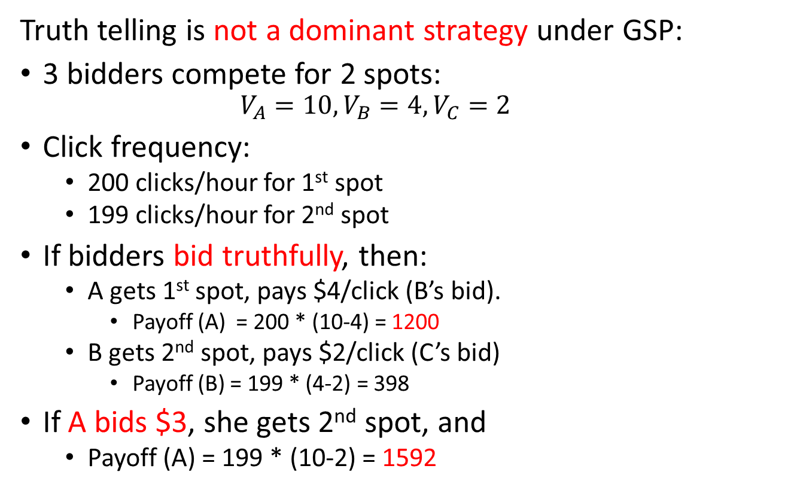
Truth Telling
Truth telling is not a dominant strategy under GSP:
3 bidders compete for 2 spots:
  $$V_{A}=10,V_{B}=4,V_{C}=2$$
Click frequency:
  200 clicks/hour for 1st spot
  199 clicks/hour for 2nd spot
If bidders bid truthfully, then:
  A gets 1st spot, pays $4/click (B’s bid).
    Payoff (A) = 200 * (10-4) = 1200
  B gets 2nd spot, pays $2/click (C’s bid)
    Payoff (B) = 199 * (4-2) = 398
If A bids $3, she gets 2nd spot, and
  Payoff (A) = 199 * (10-2) = 1592

Slide 28
Equilibrium
There is no dominant strategy under GSP
  Thus, we need to look at the equilibria
Bids can change very frequently
We have an infinitely repeated game, where:
  Advertisers initially only know their value (and not the valuations of others)
  Gradually learn the value of others trough experience
This is a repeated game with incomplete information: Gets very complex and is difficult to solve

Slide 29
Equilibrium
An easier way to analyze the outcome of the auction is to consider what happens after some time, after bids stabilize: What bids can we observe?
Some simplifying assumptions:
  Valuations are commonly known: After some time, advertisers learn all the relevant information
  Bids can change at any time: Stable bids must be best response to each other
    Stable bids must form a Nash equilibrium of the simultaneous move, one shot game of complete information
  But this isn’t enough. We want to capture dynamic aspects. We will use “simple strategies”

Slide 30
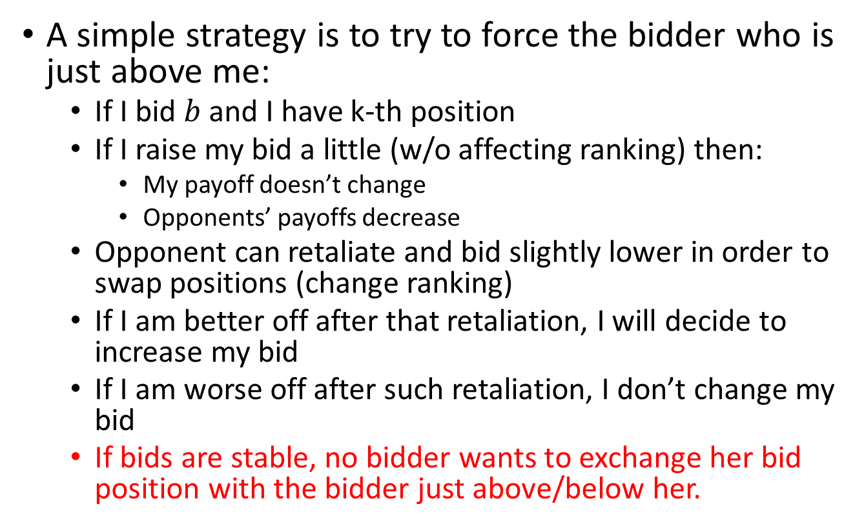
Simple Strategies
A simple strategy is to try to force the bidder who is just above me:
  If I bid $b$ and I have k-th position
  If I raise my bid a little (w/o affecting ranking) then:
    My payoff doesn’t change
    Opponents’ payoffs decrease
  Opponent can retaliate and bid slightly lower in order to swap positions (change ranking)
  If I am better off after that retaliation, I will decide to increase my bid
  If I am worse off after such retaliation, I don’t change my bid
  If bids are stable, no bidder wants to exchange her bid position with the bidder just above/below her.

Slide 31

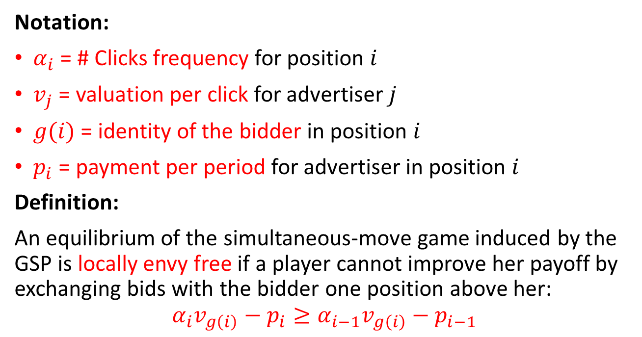
Long run equilibrium
Notation:
$α_{i}$ = # Clicks frequency for position $i$
$v_{j}$ = valuation per click for advertiser $j$
$g(i)$ = identity of the bidder in position $i$
$p_{i}$ = payment per period for advertiser in position $i$
Definition:
An equilibrium of the simultaneous-move game induced by the GSP is locally envy free if a player cannot improve her payoff by exchanging bids with the bidder one position above her:
$$α_{i}v_{g\left(i\right)}−p_{i}≥α_{i−1}v_{g\left(i\right)}−p_{i−1}$$
Payoff of bidder ranked #i
Payoff bidder ranked #i would get if assigned
position i-1 and had to pay same price bidder ranked #i-1 was paying
Notation: $p_{i−1}=α_{i−1}∗b_{i}$

Slide 32
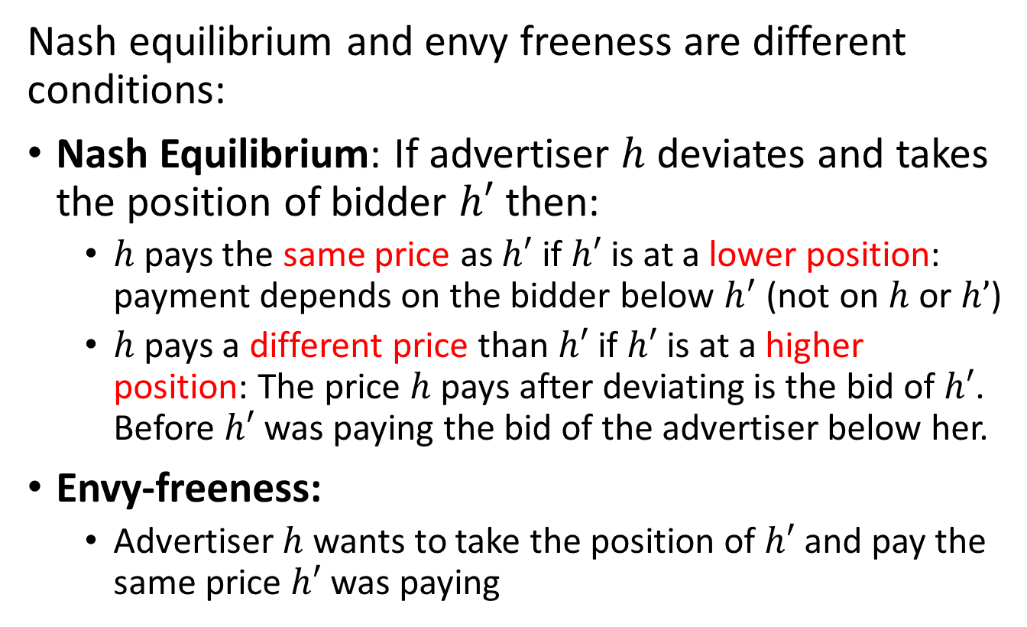
Long run equilibrium
Nash equilibrium and envy freeness are different conditions:
Nash Equilibrium: If advertiser $h$ deviates and takes the position of bidder $h′$ then:
  $h$ pays the same price as $h′$ if $h′$ is at a lower position: payment depends on the bidder below $h^{′}$ (not on $h$ or $h’$)
  $h$ pays a different price than $h′$ if $h′$ is at a higher position: The price $h$ pays after deviating is the bid of $h′$. Before $h′$ was paying the bid of the advertiser below her.
Envy-freeness:
  Advertiser $h$ wants to take the position of $h′$ and pay the same price $h′$ was paying

Slide 33
Long run equilibrium
So, the long run equilibria of the GSP auctions are given by two conditions:
  Nash equilibrium of the simultaneous-move game (one-shot, not repeated)
  Local envy-freeness condition
Such equilibria may be difficult to characterize. But, they are equivalent to stable assignments (which are easier to describe)

Slide 34
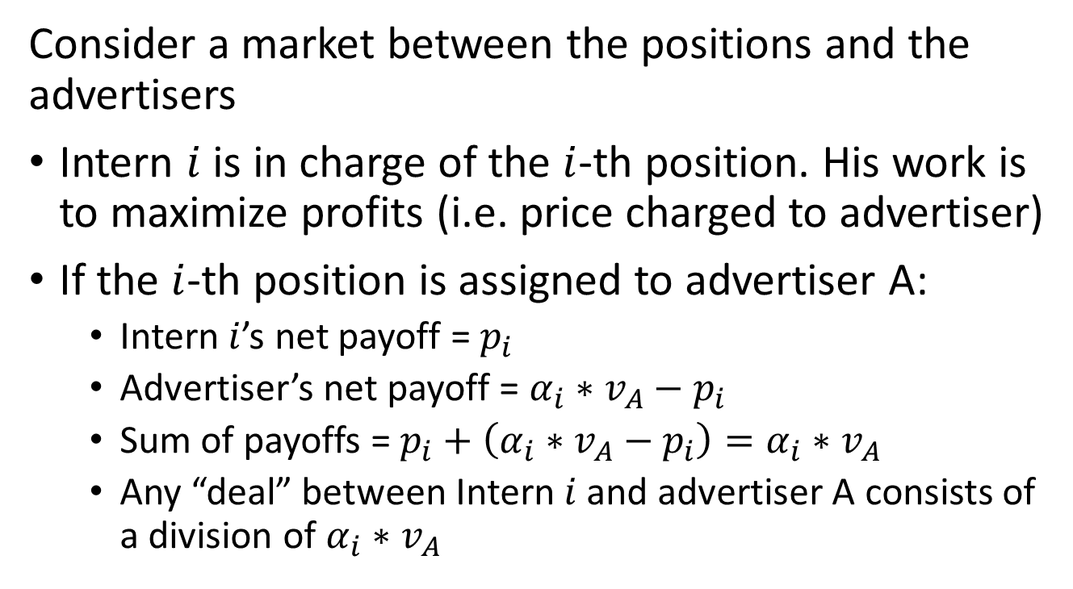
Stable Assignments
Consider a market between the positions and the advertisers
Intern $i$ is in charge of the $i$-th position. His work is to maximize profits (i.e. price charged to advertiser)
If the $i$-th position is assigned to advertiser A:
  Intern $i$’s net payoff = $p_{i}$
  Advertiser’s net payoff = $α_{i}∗v_{A}−p_{i}$
  Sum of payoffs = $p_{i}+\left(α_{i}∗v_{A}−p_{i}\right)=α_{i}∗v_{A}$
  Any “deal” between Intern $i$ and advertiser A consists of a division of $α_{i}∗v_{A}$

Slide 35
Example: Stability
Position | Advertiser | Price per click | Click Freq. | Valuation
1st | Apricot | 6 | 200 | 15
2nd | Banana | 5 | 150 | 13
Value to be shared between Intern 1 and Advertiser Apricot:
= 200 x 15 = 3,000
Intern 1’s payoff = 6 * 200 = 1,200
Value to be shared between Intern 2 and Advertiser Banana:
= 150 x 13 = 1,950
Banana’s payoff = 150 * (13-5) = 1,200
But Banana and Intern 1 together can generate 13 * 200 = 2,600. For example, with a price of 6.5 they get:
Intern 1 : 200 x 6.5 = 1,300 > 1,200
Banana: 200 x (13 – 6.5) = 1,300 > 1,200

Slide 36
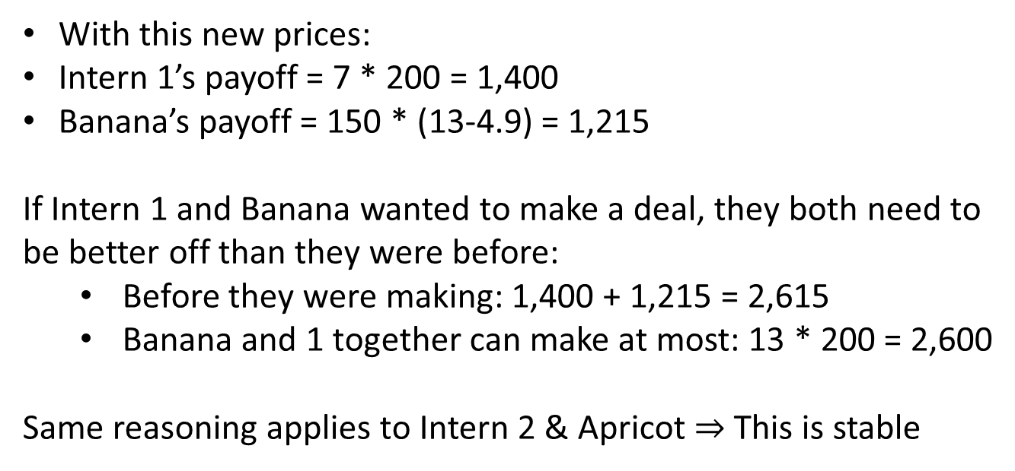
Example: Stability
Position | Advertiser | Price per click | Click Freq. | Valuation
1st | Apricot | 7 | 200 | 15
2nd | Banana | 4.9 | 150 | 13
With this new prices:
Intern 1’s payoff = 7 * 200 = 1,400
Banana’s payoff = 150 * (13-4.9) = 1,215
If Intern 1 and Banana wanted to make a deal, they both need to be better off than they were before:
  Before they were making: 1,400 + 1,215 = 2,615
  Banana and 1 together can make at most: 13 * 200 = 2,600
Same reasoning applies to Intern 2 & Apricot $⇒$ This is stable

Slide 37
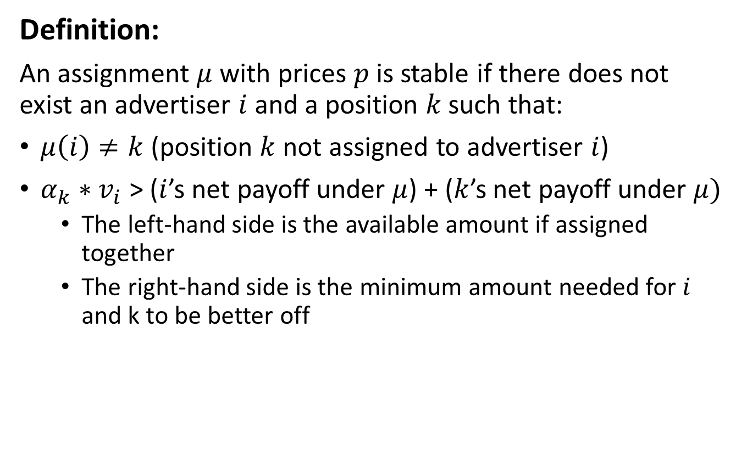
Stability
Definition:
An assignment $μ$ with prices $p$ is stable if there does not exist an advertiser $i$ and a position $k$ such that:
$μ\left(i\right)≠k$ (position $k$ not assigned to advertiser $i$)
$α_{k}∗v_{i}$ > ($i$’s net payoff under $μ$) + ($k$’s net payoff under $μ)$
  The left-hand side is the available amount if assigned together
  The right-hand side is the minimum amount needed for $i$ and k to be better off

Slide 38
Stability
Remember that:
Stable assignments are known to be a critical property in real-life market
Markets that don’t produce stable assignments usually collapse

Slide 39
Equilibrium vs Stable Assignments
Long run equilibria and stability obey 2 different logics:
Equilibria: Only the bidder deviates. If a bidder deviates and takes a new position, she doesn’t need to ask that position’s permission
  A bidder deviates if she is better off. It doesn’t matter if the position gets lower revenue
Stability: If a bidder wants a different position, that will be possible only if the position agrees:
  It is not sufficient that the advertiser is better of at the new position
  The new position also needs to be better off

Slide 40
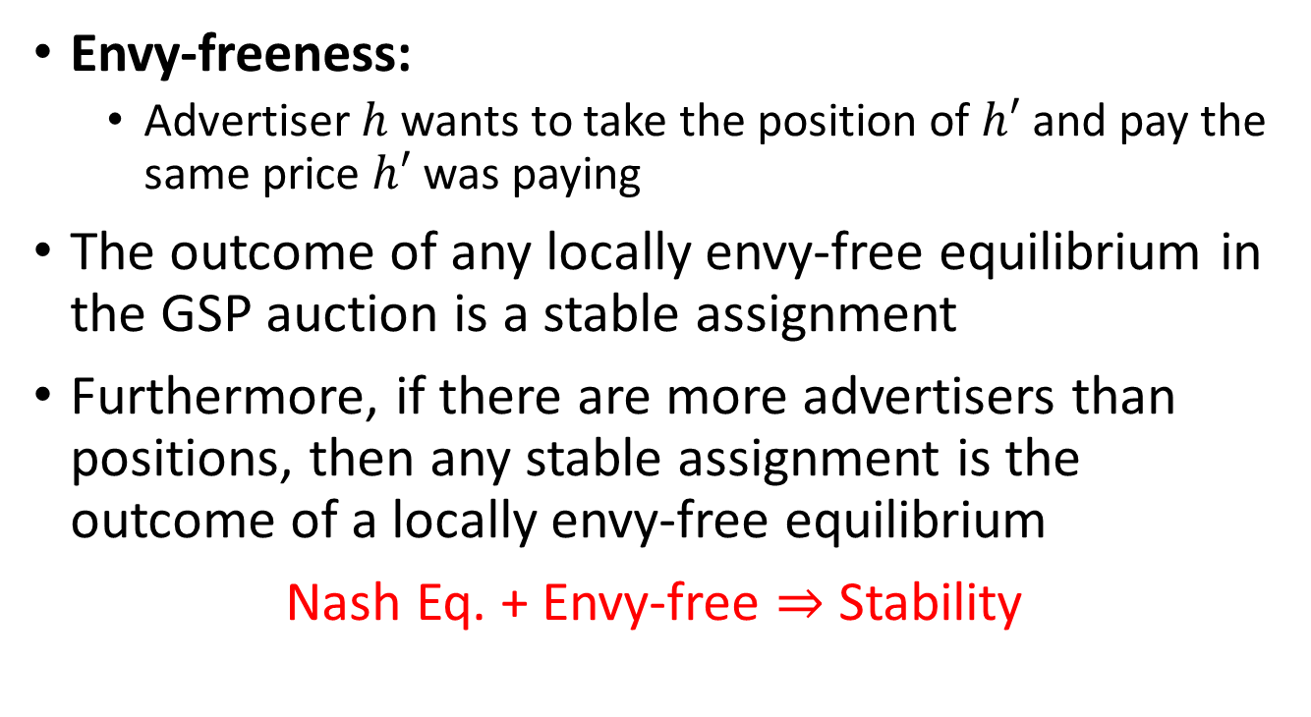
What is the relationship w/
Envy-Freeness
Envy-freeness:
  Advertiser $h$ wants to take the position of $h′$ and pay the same price $h′$ was paying
The outcome of any locally envy-free equilibrium in the GSP auction is a stable assignment
Furthermore, if there are more advertisers than positions, then any stable assignment is the outcome of a locally envy-free equilibrium
Nash Eq. + Envy-free $⇒$ Stability

Slide 41
Generalized English Auction
The Vickrey auction is a one-shot/simultaneous version of the English auction
We are going to define a “Generalized English Auction” so that the GSP would be its one-shot/simultaneous version

Slide 42
Generalized English Auction
Rules:
Start price is 0. All advertisers are in the auction
There is a clock showing the current price, which increases over time
Advertisers can drop at any time. Their bid is the price in the clock when they drop out
Auction ends when the next-to-last advertisers drops out
Outcome:
Last advertiser ranked 1st, all other ranked according to the time they dropped out (the latest, the higher)
Each advertiser pays the bid of the advertiser ranked just below him/her

Slide 43

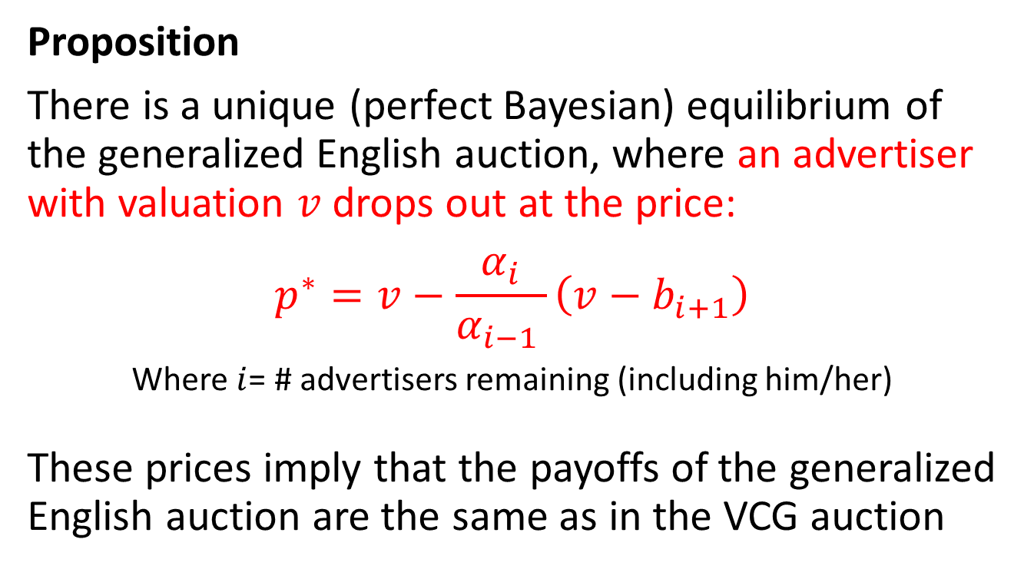
Generalized English Auction
Proposition
There is a unique (perfect Bayesian) equilibrium of the generalized English auction, where an advertiser with valuation $v$ drops out at the price:
$$p^{∗}=v−\frac{α_{i}}{α_{i−1 }}\left(v−b_{i+1}\right)$$
Where $i$= # advertisers remaining (including him/her)
These prices imply that the payoffs of the generalized English auction are the same as in the VCG auction
Remember $α_{i}$ is the click frequency of position $i$

Slide 44
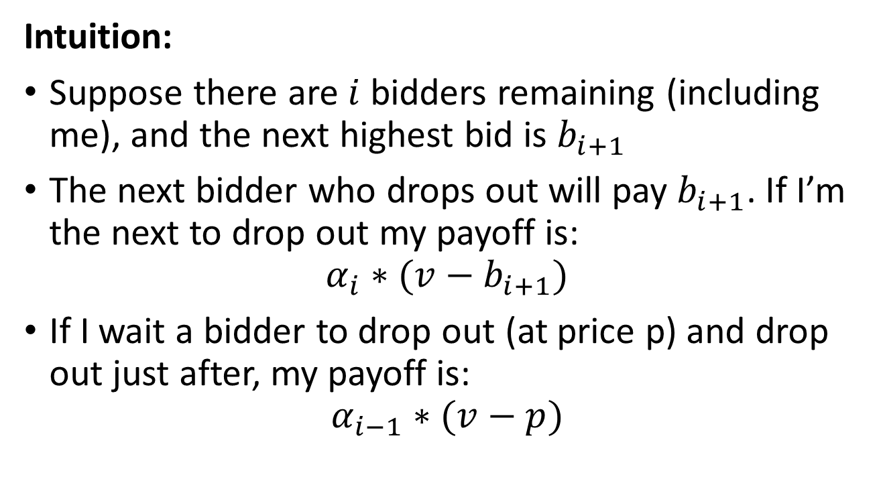
Generalized English Auction
Intuition:
Suppose there are $i$ bidders remaining (including me), and the next highest bid is $b_{i+1}$
The next bidder who drops out will pay $b_{i+1}$. If I’m the next to drop out my payoff is:
$$α_{i}∗(v−b_{i+1})$$
If I wait a bidder to drop out (at price p) and drop out just after, my payoff is:
$$α_{i−1}∗(v−p)$$

Slide 45
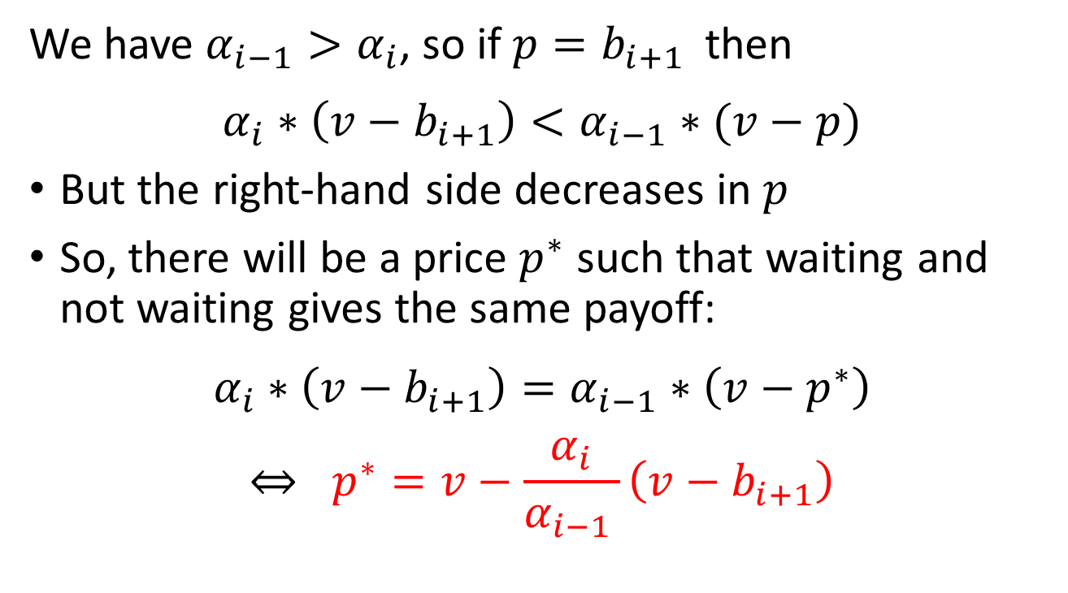
Generalized English Auction
We have $α_{i−1}>α_{i}$, so if $p=b_{i+1 }$ then
$$α_{i}∗\left(v−b_{i+1}\right)<α_{i−1}∗(v−p)$$
But the right-hand side decreases in $p$
So, there will be a price $p^{∗}$ such that waiting and not waiting gives the same payoff:
$$α_{i}∗\left(v−b_{i+1}\right)=α_{i−1}∗\left(v−p^{∗}\right)$$
$$⇔ p^{∗}=v−\frac{α_{i}}{α_{i−1 }}\left(v−b_{i+1}\right)$$

Slide 46
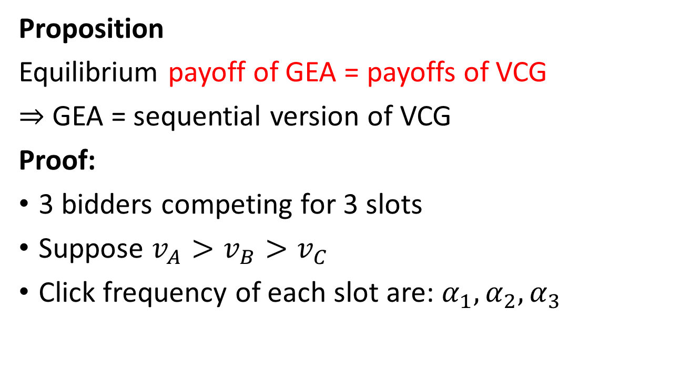
Comparing GEA and VCG
Proposition
Equilibrium payoff of GEA = payoffs of VCG
$⇒$ GEA = sequential version of VCG
Proof:
3 bidders competing for 3 slots
Suppose $v_{A}>v_{B}>v_{C}$
Click frequency of each slot are: $α_{1},α_{2},α_{3}$

Slide 47
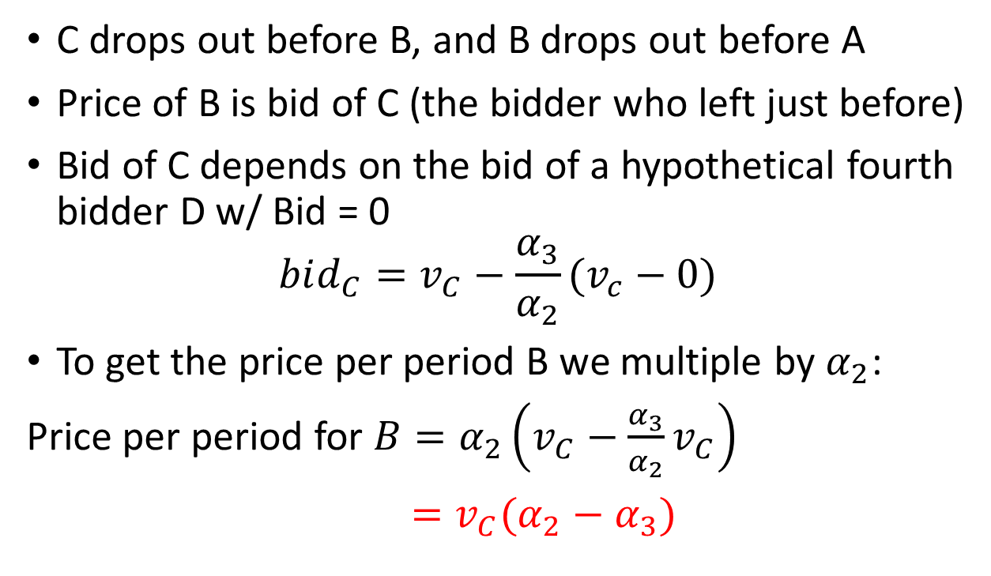
Proof continued (Price w/GEA)
C drops out before B, and B drops out before A
Price of B is bid of C (the bidder who left just before)
Bid of C depends on the bid of a hypothetical fourth bidder D w/ Bid = 0
$$bid_{C}=v_{C}−\frac{α_{3}}{α_{2}}(v_{c}−0)$$
To get the price per period B we multiple by $α_{2}$:
Price per period for ${B=α}_{2}\left(v_{C}−\frac{α_{3}}{α_{2}}v_{C}\right)$
$=v_{C}(α_{2}−α_{3})$

Slide 48
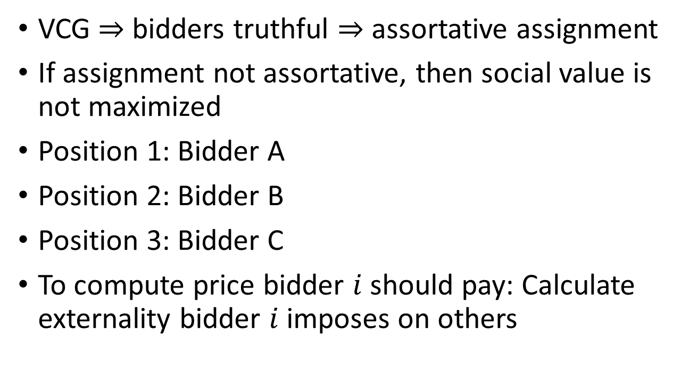
Proof continued (Price w/VCG)
VCG $⇒$ bidders truthful $⇒$ assortative assignment
If assignment not assortative, then social value is not maximized
Position 1: Bidder A
Position 2: Bidder B
Position 3: Bidder C
To compute price bidder $i$ should pay: Calculate externality bidder $i$ imposes on others

Slide 49
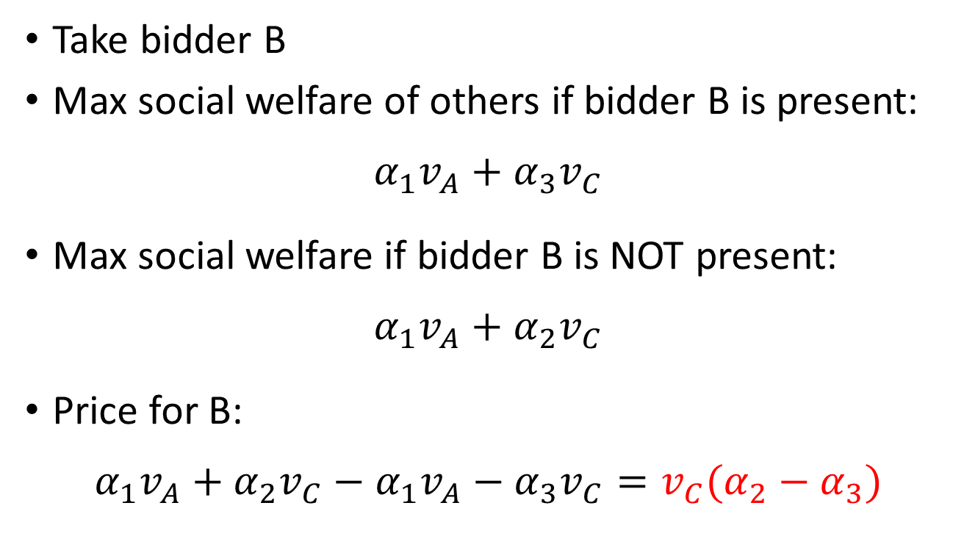
Proof continued (Price w/VCG)
Take bidder B
Max social welfare of others if bidder B is present:
$$α_{1}v_{A}+α_{3}v_{C}$$
Max social welfare if bidder B is NOT present:
$$α_{1}v_{A}+α_{2}v_{C}$$
Price for B:
$$α_{1}v_{A}+α_{2}v_{C}−α_{1}v_{A}−α_{3}v_{C}=v_{C}(α_{2}−α_{3})$$

Slide 50
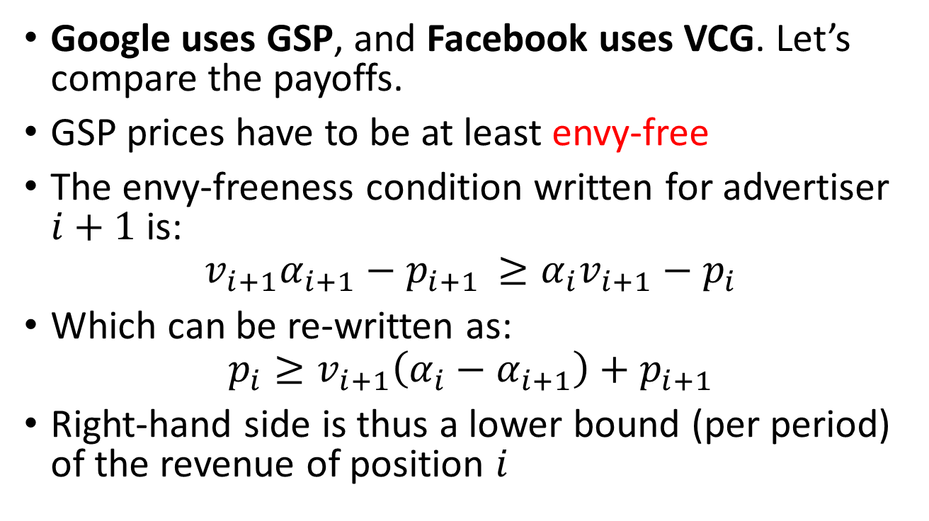
Comparing VCG and GSP
Google uses GSP, and Facebook uses VCG. Let’s compare the payoffs.
GSP prices have to be at least envy-free
The envy-freeness condition written for advertiser $i+1$ is:
$$v_{i+1}α_{i+1}−p_{i+1 }≥α_{i}v_{i+1}−p_{i}$$
Which can be re-written as:
$$p_{i}≥v_{i+1}\left(α_{i}−α_{i+1}\right)+p_{i+1}$$
Right-hand side is thus a lower bound (per period) of the revenue of position $i$

Slide 51
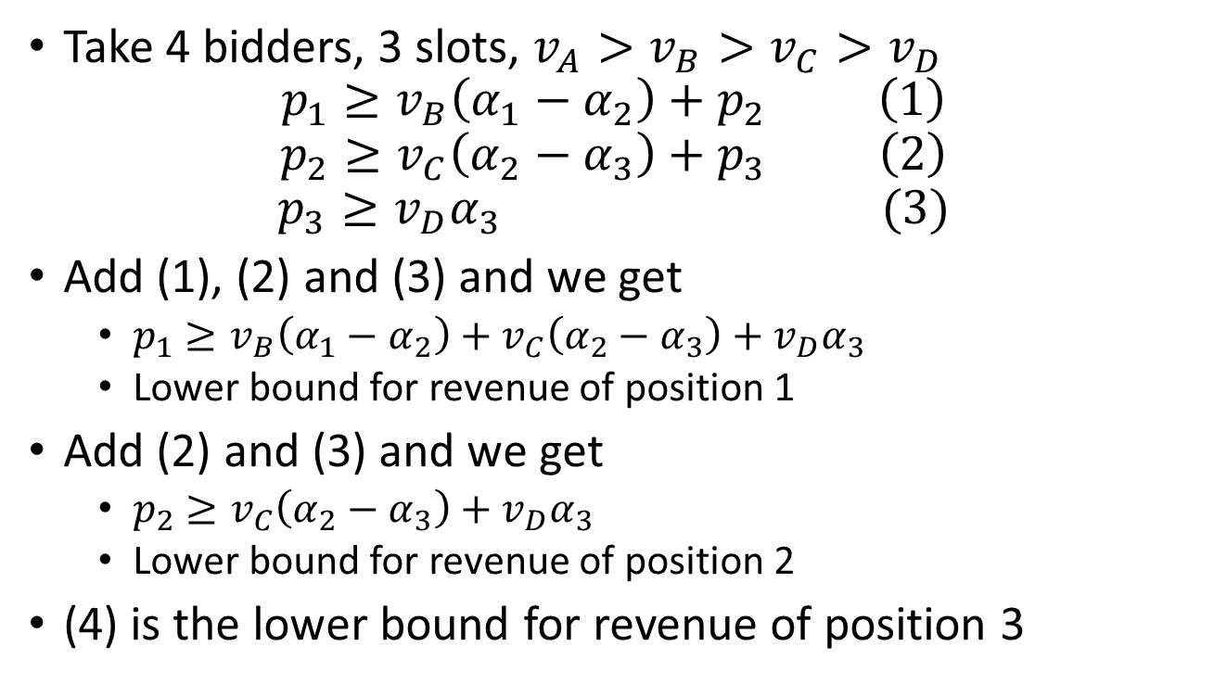
Comparing VCG and GSP
Take 4 bidders, 3 slots, $v_{A}>v_{B}>v_{C}>v_{D}$
$$p_{1}≥v_{B}\left(α_{1}−α_{2}\right)+p_{2} \left(1\right)$$
$$p_{2}≥v_{C}\left(α_{2}−α_{3}\right)+p_{3} \left(2\right)$$
$$p_{3}≥v_{D}α_{3} (3)$$
Add (1), (2) and (3) and we get
  $p_{1}≥v_{B}\left(α_{1}−α_{2}\right)+v_{C}\left(α_{2}−α_{3}\right)+v_{D}α_{3}$
  Lower bound for revenue of position 1
Add (2) and (3) and we get
  $p_{2}≥v_{C}\left(α_{2}−α_{3}\right)+v_{D}α_{3}$
  Lower bound for revenue of position 2
(4) is the lower bound for revenue of position 3

Slide 52
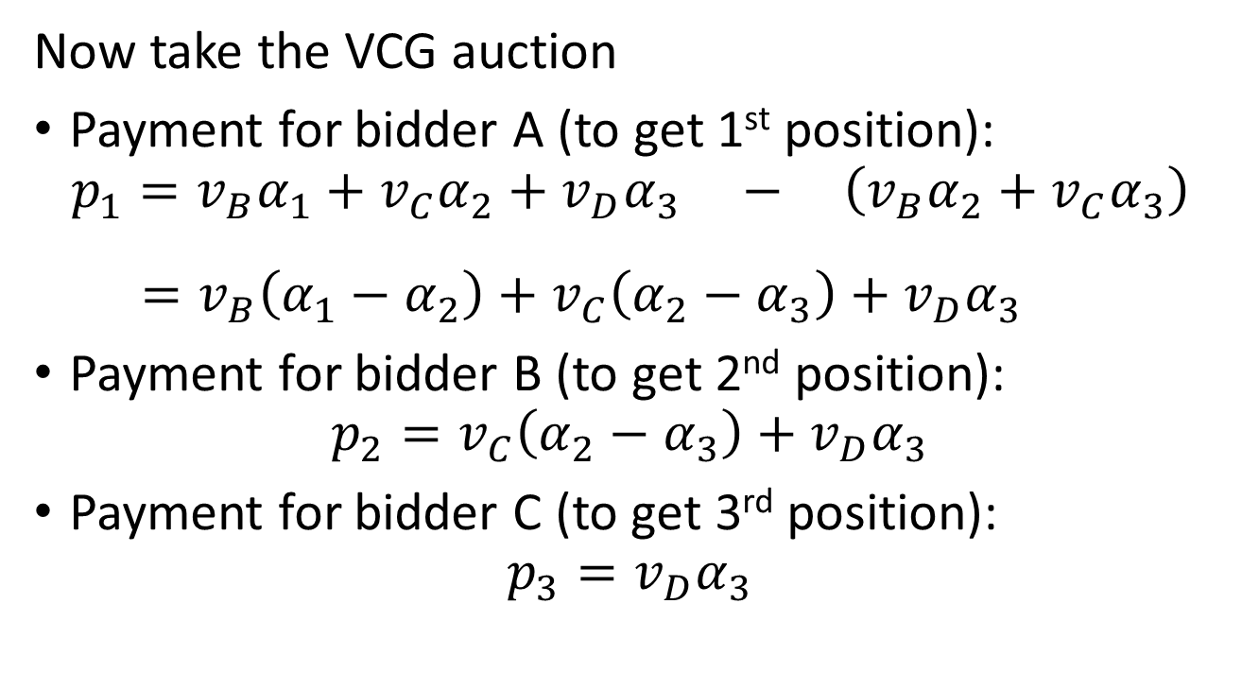
Comparing VCG and GSP
Now take the VCG auction
Payment for bidder A (to get 1st position):
$$p_{1}=v_{B}α_{1}+v_{C}α_{2}+v_{D}α_{3} − \left(v_{B}α_{2}+v_{C}α_{3}\right)$$
$$=v_{B}\left(α_{1}−α_{2}\right)+v_{C}\left(α_{2}−α_{3}\right)+v_{D}α_{3}$$
Payment for bidder B (to get 2nd position):
$$p_{2}=v_{C}\left(α_{2}−α_{3}\right)+v_{D}α_{3}$$
Payment for bidder C (to get 3rd position):
$$p_{3}=v_{D}α_{3}$$
Max social value w/ A not here
Social value of others w/ A not here

Slide 53
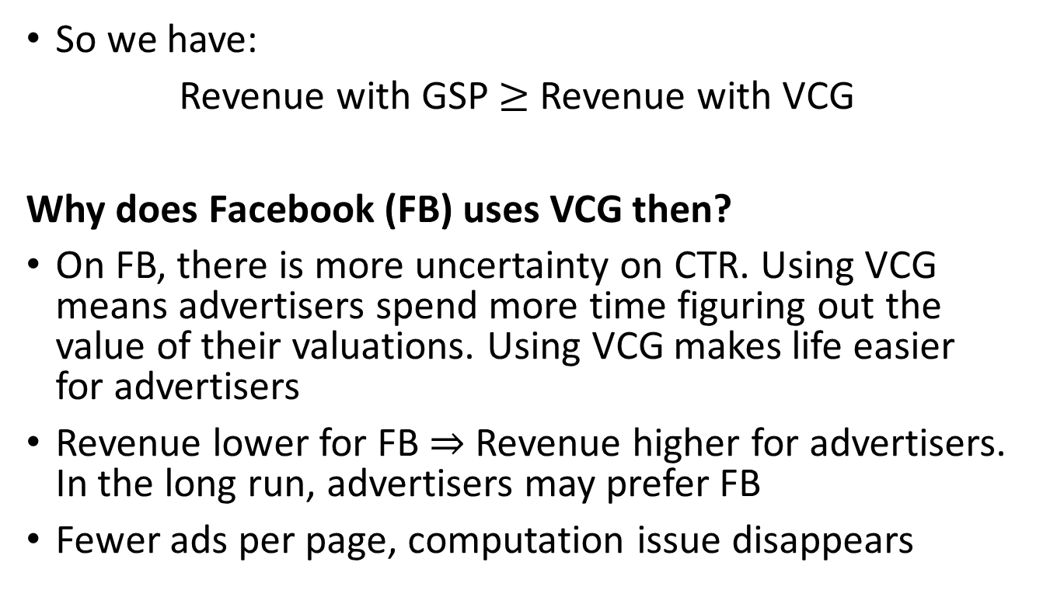
Comparing VCG and GSP
So we have:
Revenue with GSP $≥$ Revenue with VCG
Why does Facebook (FB) uses VCG then?
On FB, there is more uncertainty on CTR. Using VCG means advertisers spend more time figuring out the value of their valuations. Using VCG makes life easier for advertisers
Revenue lower for FB $⇒$ Revenue higher for advertisers. In the long run, advertisers may prefer FB
Fewer ads per page, computation issue disappears

Slide 54
This is a search ad:
Likelihood of a click is high. Search engine is not competing with other ad-tech firms for the advertising spot.
These are generally sold through GSP

Slide 55
Facebook is not competing with any other ad-tech firm when showing ads in their page. Also note that the likelihood of a click on an Ad on Facebook is much lower than a click on a search Ad. Facebook uses VCG, because although it creates less revenues than GSP, it makes it easier/better for advertisers.

Slide 56
Going back to first price auctions
In the last two years the industry has been moving back to first price auctions
Google announced on Oct 7, 2021 that was moving AdSense (display advertising) to first-price in the “coming months”. WHY?
  There are moving AdSense not search advertising
  Display advertising done by online publishers that usually connect to multiple AdExchanges and allocate slots to the one offering the best price
  AdSense was frequently losing to other exchanges
  The problem we saw with Go-To in the beginning of the industry will not happen, because now there is competition between multiple exchanges

Slide 57
This is an example of display advertising: The New York Times contacted several ad-tech firms and told them I was looking at their page, and asked them how much they are willing to pay to sell me an Ad. Each of those firms run an auction and made an offer to the NY Times. The highest bidder got the impression. This are the auctions that have been moving to first price.

Slide 58
Take Away
Most ads in the internet are allocated through an auction
Bidders have valuations per click, but make decisions considering cost per click AND the click-through-rate (click frequency)
A popular format is the generalized second-price auction:
  Advertisers place one bid for a spot on the page
  Advertisers allocated spots so that: Highest bidder gets the best spot (highest CTR), the second highest bidder …
  Bidders pay per click the bid of the bidder ranked just below them
  Auctioneer also adjust bids using a “quality score”

Slide 59
Take Away
Truthful bidding is not a dominant strategy with GSP
Long run equilibrium of the repeated GSP game yield stable assignments
Generalized English Auction is the sequential version of VCG
Website’s revenue are higher with the GSP than with the VCG
In practice websites multiply advertisers with a quality score: Maximizes the payoff flows for the website
Some websites (e.g. Facebook) uses the VCG auction

